Slide 1
Hebb’s Rules

Slide 2

ANN Learning rules
McCulloch-Pitts neuron capable of: storing information and producing logical and arithmetical operations on it.
The next step must be to realise another important function of the brain, which is to acquire new knowledge through experience, i.e. learning.

Slide 3
ANN Learning rules
Learning means
to change in response to experience.
In a network of MP-neurons binary weights of connections and thresholds are fixed. The only change can be the change of pattern of connections, which is technically expensive.
Some easily changeable free parameters are needed.

Slide 4
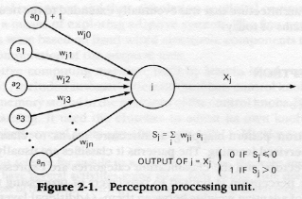
ANN Learning rules
Abstract neuron.
The ideal free parameters to adjust, and so to resolve learning without changing pattern of connections, are the weights of connections w_{ji}.

Slide 5
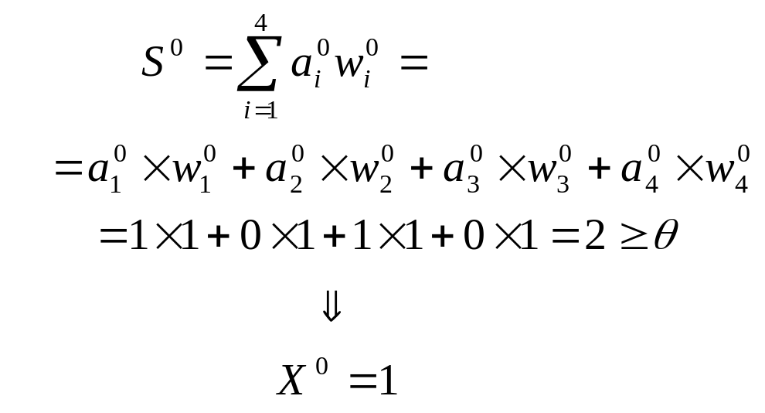
Hebb’s rule in practice
Input unit
Nº
1
2
3
4
t=0 C=1
a⁰1 | a⁰2 | a⁰3 | a⁰4
1 | 0 | 1 | 0
w⁰1 | w⁰2 | w⁰3 | w⁰4
1 | 1 | 1 | 1
1
1
1
0
θ =2
X
1
1
1
0

Slide 6
Hebb’s rule in practice
Input unit
Nº
1
2
3
4
t=0 C=1
a⁰1 | a⁰2 | a⁰3 | a⁰4
1 | 0 | 1 | 0
w⁰1 | w⁰2 | w⁰3 | w⁰4
1 | 1 | 1 | 1
1
1
1
0
θ =2
X
1
1
1
0

Slide 7
Hebb’s rule in practice
Input unit
Nº
1
2
3
4
t=0 C=1
a⁰1 | a⁰2 | a⁰3 | a⁰4
1 | 0 | 1 | 0
w⁰1 | w⁰2 | w⁰3 | w⁰4
1 | 1 | 1 | 1
1
1
1
0
θ =2
1
1
1
1
0

Slide 8
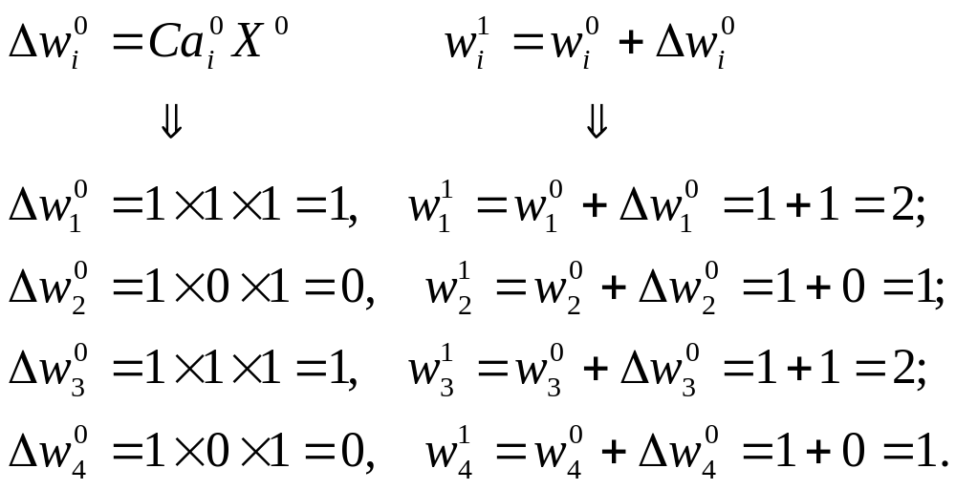
Hebb’s rule in practice
Input unit
Nº
1
2
3
4
t=0 C=1
a⁰1 | a⁰2 | a⁰3 | a⁰4
1 | 0 | 1 | 0
w⁰1 | w⁰2 | w⁰3 | w⁰4
1 | 1 | 1 | 1
1
1
0
1
θ =2
1
1
1
1
0

Slide 9
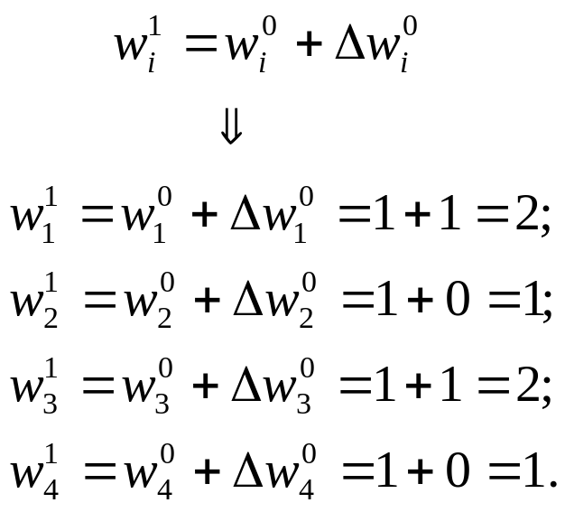
Hebb’s rule in practice
a⁰1 | a⁰2 | a⁰3 | a⁰4
1 | 0 | 1 | 0
Input unit
Nº
1
2
3
4
t=1 C=1
w¹1 | w¹2 | w¹3 | w¹4
2 | 1 | 2 | 1
2
1
θ =2
X
2
1

Slide 10
Hebb’s rule in practice
Input unit
Nº
1
2
3
4
t=1 C=1
w¹1 | w¹2 | w¹3 | w¹4
2 | 1 | 2 | 1
2
1
θ =2
X
2
1

Slide 11
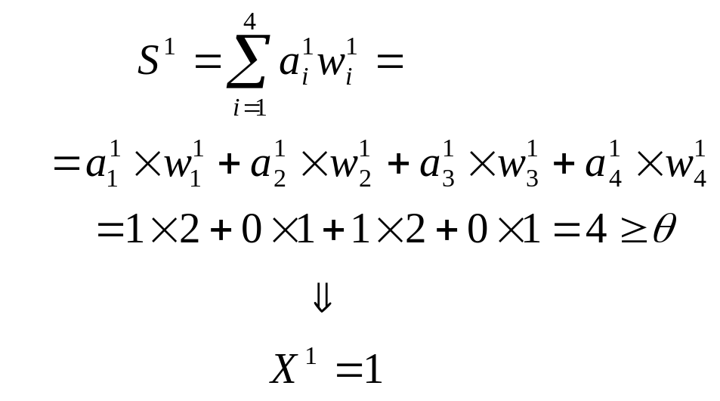
Hebb’s rule in practice
Input unit
Nº
1
2
3
4
t=1 C=1
a¹1 | a¹2 | a¹3 | a¹4
1 | 0 | 1 | 0
w¹1 | w¹2 | w¹3 | w¹4
2 | 1 | 2 | 1
1
2
0
1
θ =2
X
1
2
1
0

Slide 12
Hebb’s rule in practice
Input unit
Nº
1
2
3
4
t=1 C=1
a¹1 | a¹2 | a¹3 | a¹4
1 | 0 | 1 | 0
w¹1 | w¹2 | w¹3 | w¹4
2 | 1 | 2 | 1
1
2
0
1
θ =2
X
1
2
1
0

Slide 13
Hebb’s rule in practice
Input unit
Nº
1
2
3
4
t=1 C=1
a¹1 | a¹2 | a¹3 | a¹4
1 | 0 | 1 | 0
w¹1 | w¹2 | w¹3 | w¹4
2 | 1 | 2 | 1
1
2
0
1
θ =2
1
1
2
1
0

Slide 14
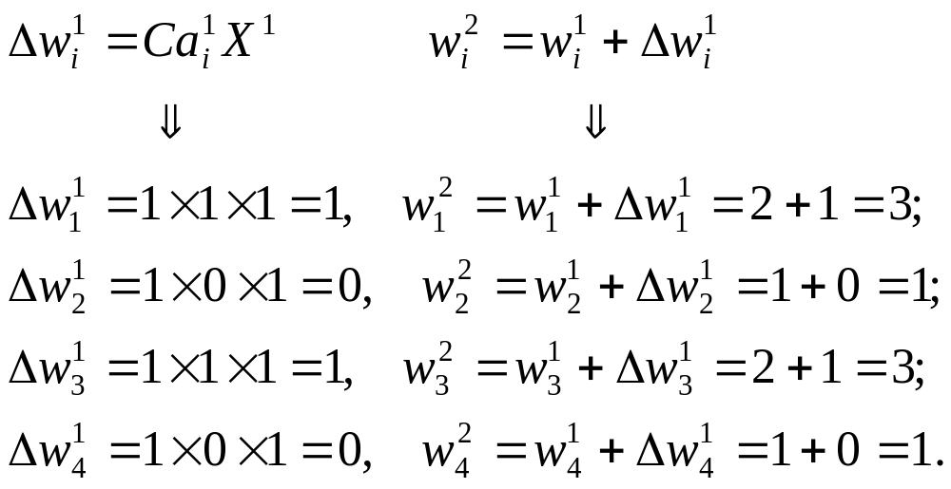
Hebb’s rule in practice
Input unit
Nº
1
2
3
4
t=1 C=1
a¹1 | a¹2 | a¹3 | a¹4
1 | 0 | 1 | 0
w¹1 | w¹2 | w¹3 | w¹4
2 | 1 | 2 | 1
1
2
0
1
θ =2
1
1
2
1
0

Slide 15
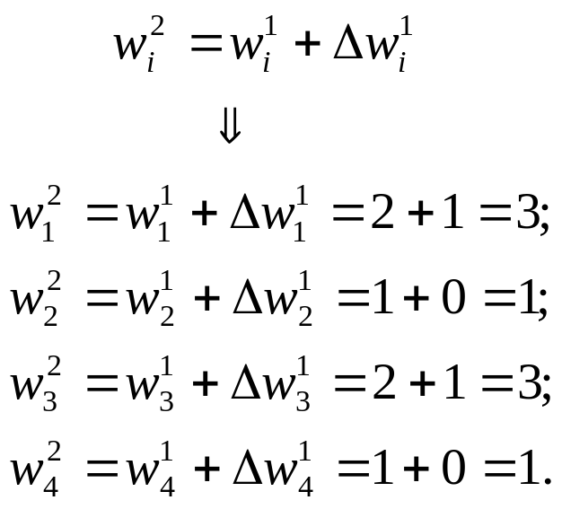
Hebb’s rule in practice
a¹1 | a¹2 | a¹3 | a¹4
1 | 0 | 1 | 0
Input unit
Nº
1
2
3
4
t=2 C=1
w²1 | w²2 | w²3 | w²4
3 | 1 | 3 | 1
3
1
θ =2
X
3
1

Slide 16
Hebb’s rule in practice
Input unit
Nº
1
2
3
4
t=2 C=1
w²1 | w²2 | w²3 | w²4
3 | 1 | 3 | 1
3
1
θ =2
X
3
1

Slide 17
Hebb’s rule in practice
Input unit
Nº
1
2
3
4
t=2 C=1
a²1 | a²2 | a²3 | a²4
w²1 | w²2 | w²3 | w²4
3 | 1 | 3 | 1
3
1
θ =2
X
3
1

Slide 18
Hebb’s rule in practice
Input unit
Nº
1
2
3
4
t=2 C=1
a²1 | a²2 | a²3 | a²4
1 | 0 | 1 | 0
w²1 | w²2 | w²3 | w²4
3 | 1 | 3 | 1
1
3
0
1
θ =2
X
1
3
1
0

Slide 19
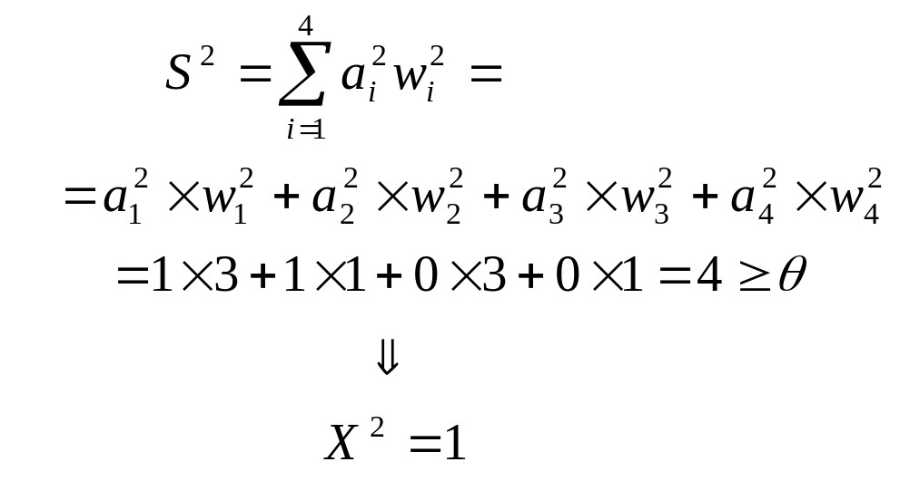
Hebb’s rule in practice
Input unit
Nº
1
2
3
4
t=2 C=1
a²1 | a²2 | a²3 | a²4
1 | 1 | 0 | 0
w²1 | w²2 | w²3 | w²4
3 | 1 | 3 | 1
1
3
1
1
θ =2
X
0
3
1
0

Slide 20
Hebb’s rule in practice
Input unit
Nº
1
2
3
4
t=2 C=1
a²1 | a²2 | a²3 | a²4
1 | 1 | 0 | 0
w²1 | w²2 | w²3 | w²4
3 | 1 | 3 | 1
1
3
1
1
θ =2
1
0
3
1
0

Slide 21
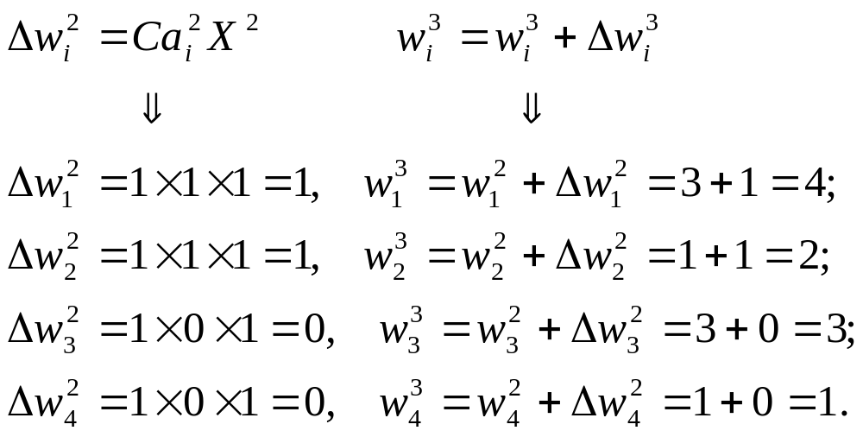
Hebb’s rule in practice
Input unit
Nº
1
2
3
4
t=2 C=1
a²1 | a²2 | a²3 | a²4
1 | 1 | 0 | 0
w²1 | w²2 | w²3 | w²4
3 | 1 | 3 | 1
1
3
1
1
θ =2
1
0
3
1
0

Slide 22
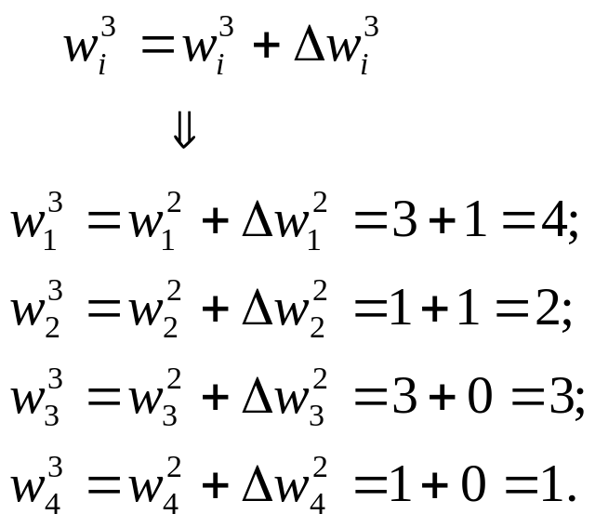
Hebb’s rule in practice
a²1 | a²2 | a²3 | a²4
1 | 1 | 0 | 0
Input unit
Nº
1
2
3
4
t=3 C=1
w³1 | w³2 | w³3 | w³4
4 | 2 | 3 | 1
4
2
θ =2
X
3
1

Slide 23
Hebb’s rule in practice
Input unit
Nº
1
2
3
4
t=3 C=1
w³1 | w³2 | w³3 | w³4
4 | 2 | 3 | 1
4
2
θ =2
X
3
1
And so on…

Slide 24
Next - Perceptron (1958)
Rosenblatt (1958) explicitly considered the problem of pattern recognition, where a “teacher” is essential.

